Slide 1
4
TEAM
4
TEAM
By Ethan Audley, Elliot Bowman, Jacob Major and Jonathan Morgan

Slide 2
Introduction
4
TEAM
Team Roles Who We Are:
Jonathan Morgan
Job Role: Project Manager
: Level Design , Item Pickups
Elliott Bowman
Job Role: Secretary
: Time Rewind
Ethan Audley
: UI Designer
Jacob Major
Job Role : Chairman
: Characters , AI
What our game is:
Stealth dungeon game. Find your way through the dungeon and escape, without being scene by the enemy skeletons.
What Makes our game unique:
Use the character’s unique abilities, such as time rewinding, to avoid any deaths or trapped situations.

Slide 3


Platform
4
TEAM
Platform:
The Game will be available on Android devices and possibly iOS in the near future.
Genre:
Third-person isometric stealth game.
Intended audience 8+ due to some aspects of violence.
Modes:
Single-Player Game. Time Scores.
Engine:
Unity 5.5

Slide 4
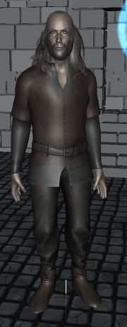
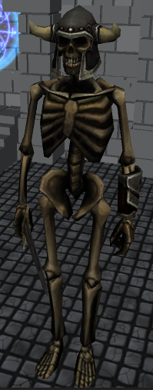
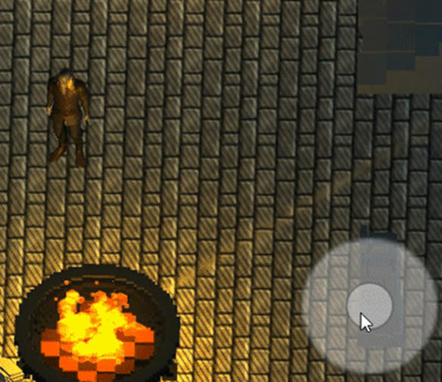
Characters
4
TEAM
Protagonist
Antagonist
Controlled by joy stick and the press of an on screen buttons for other abilities
Will be able to pick up items which are accessible via an inventory
Able to detect the protagonist via a field of view and distance
Once spotted protagonist, will chase until either defeated or to far away

Slide 5
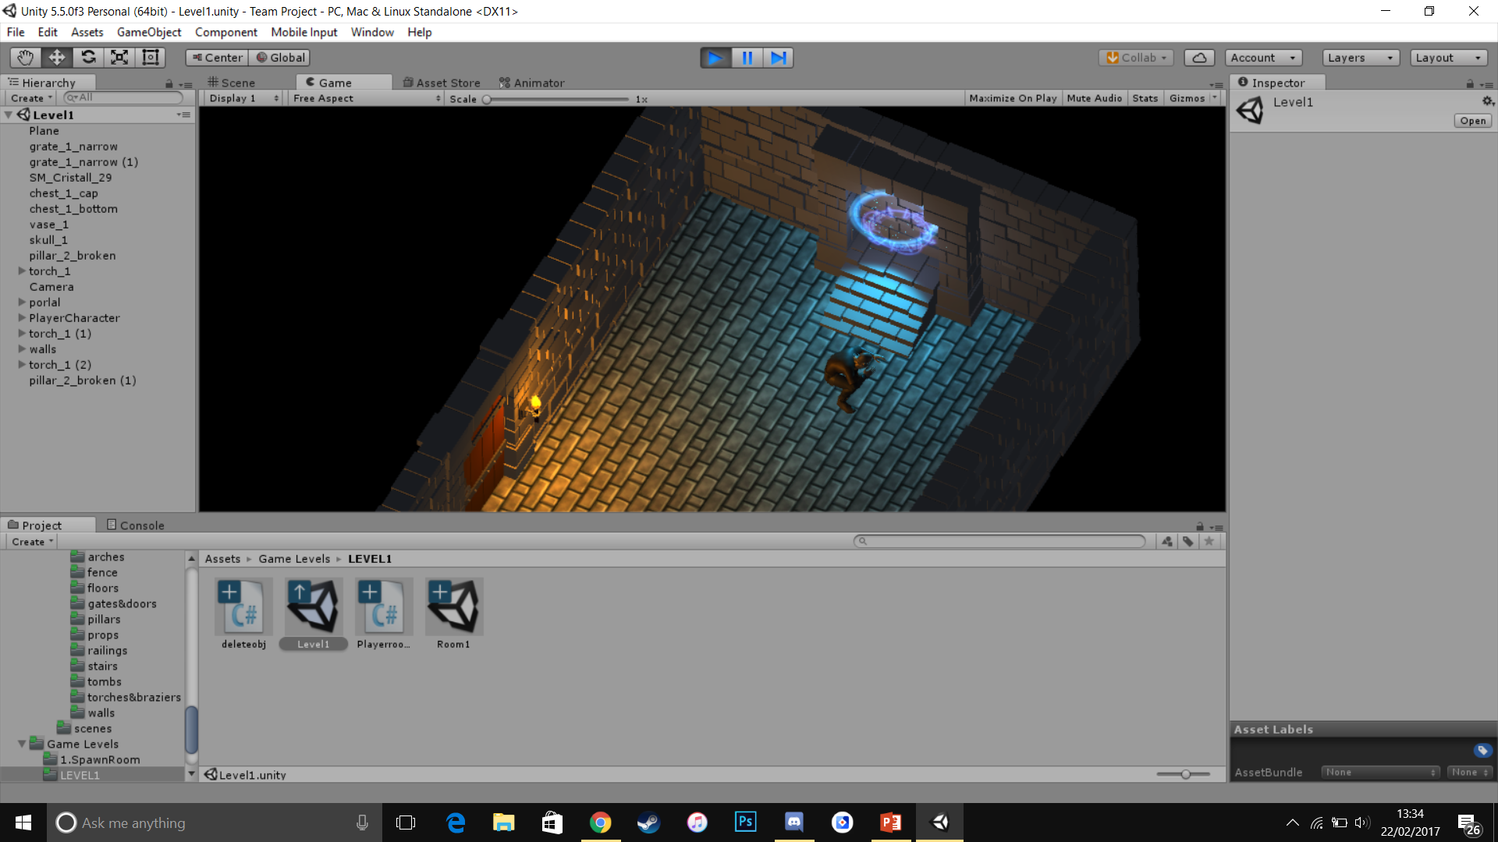
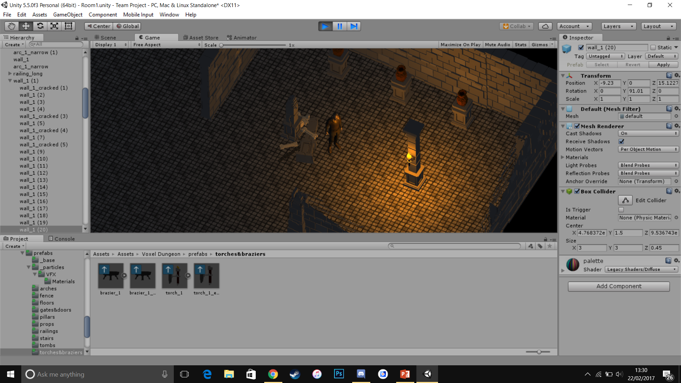
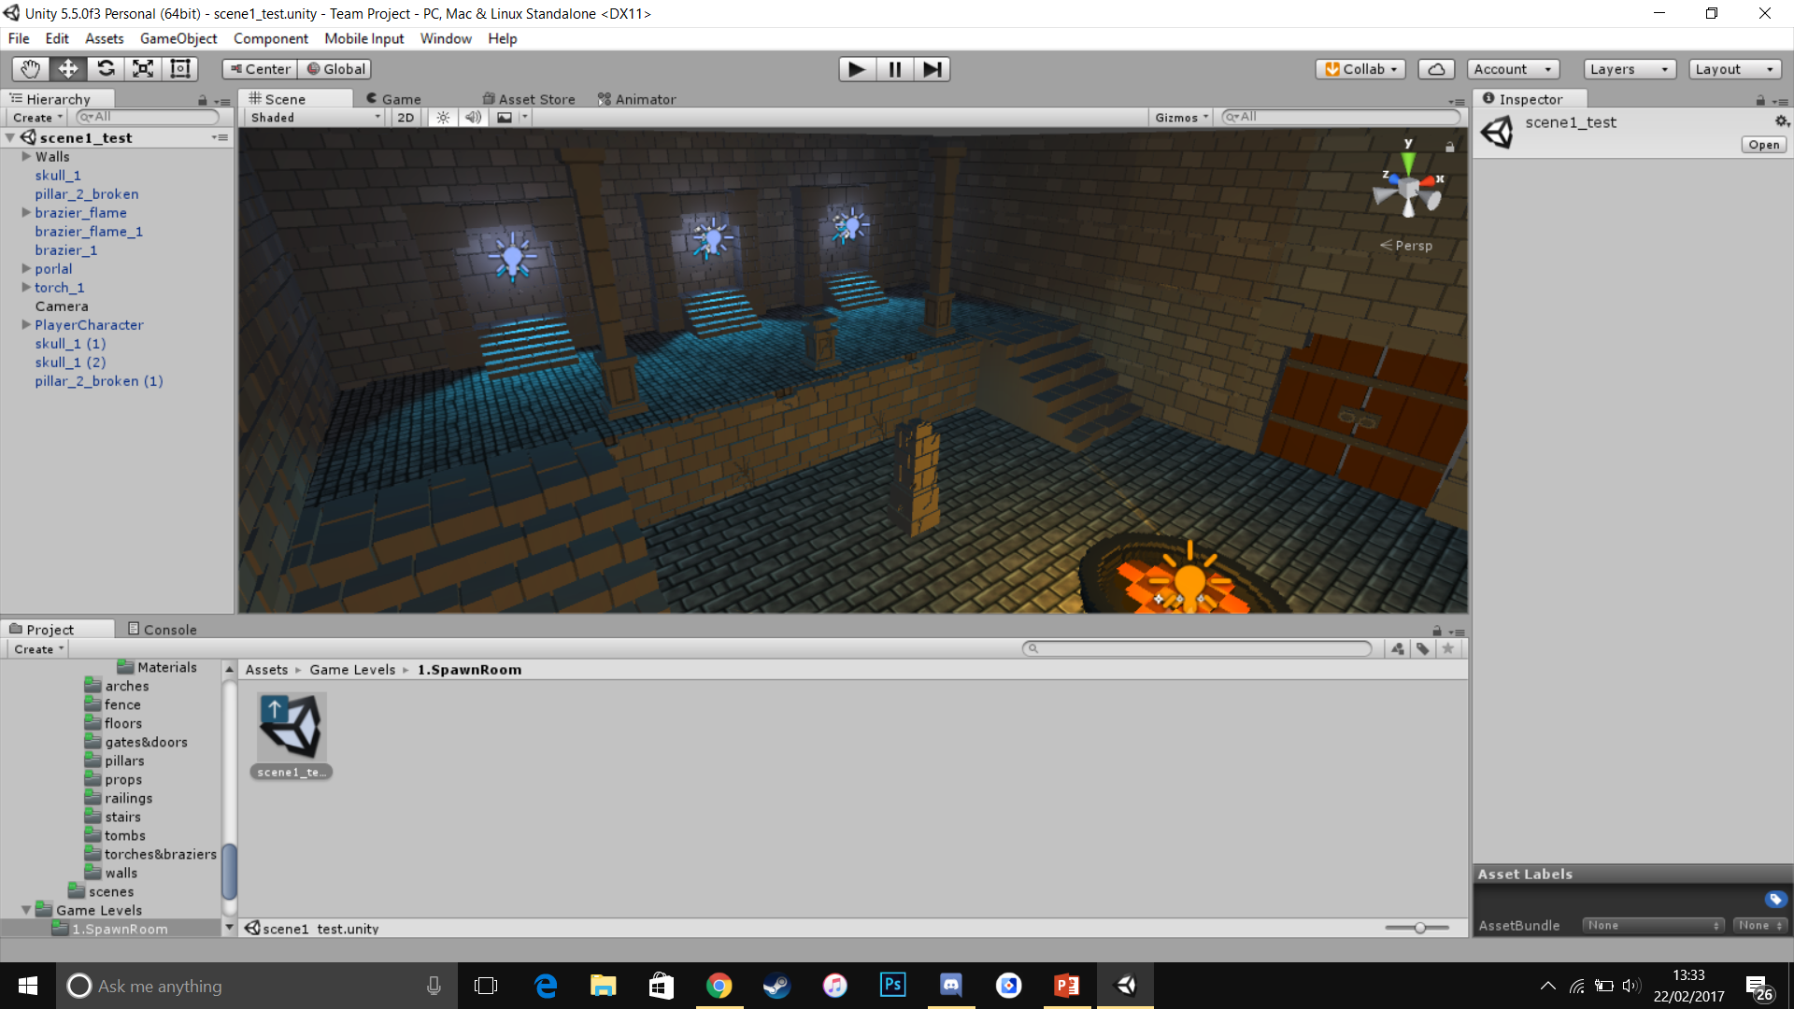
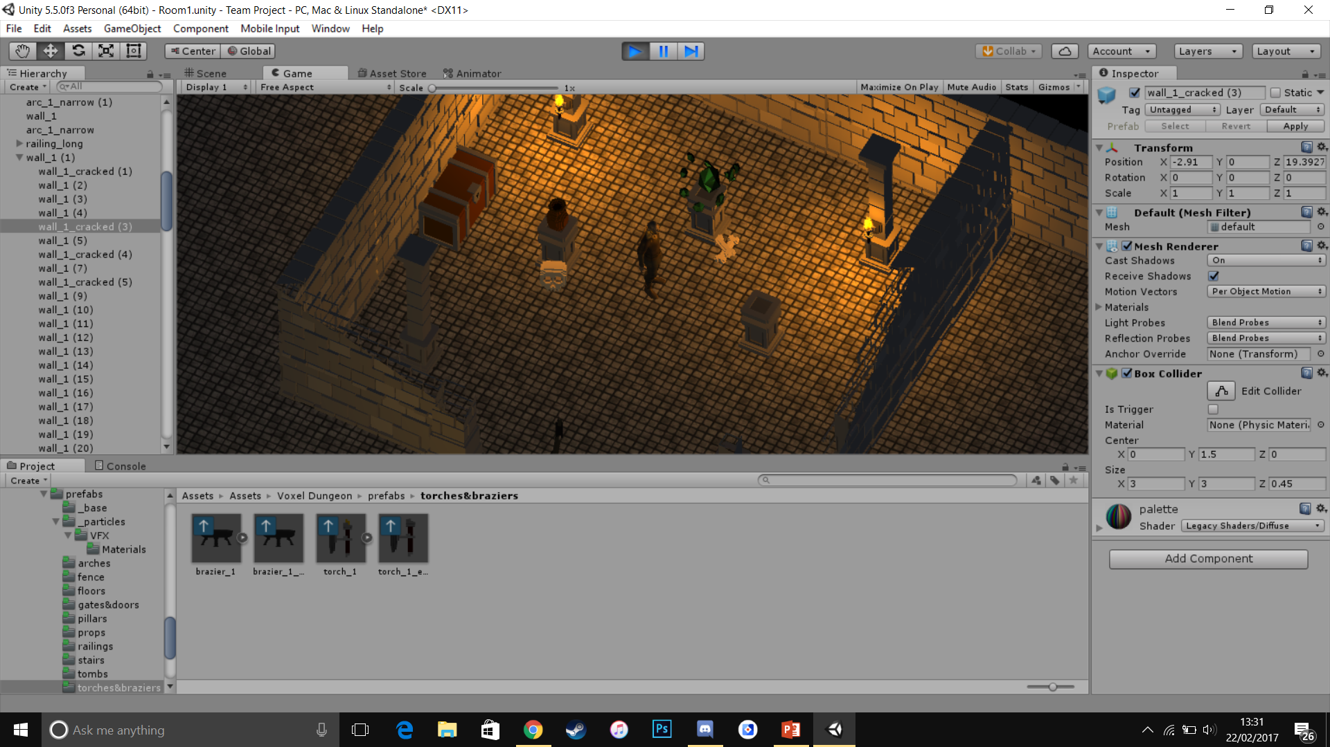
Level Design
4
TEAM
Level Design:
All levels connected by main hub world
Portals take the player between levels
Each level will be set out with many items and strategically-placed enemies

Slide 6
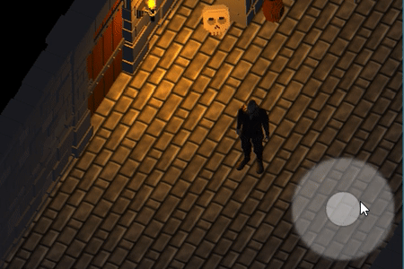
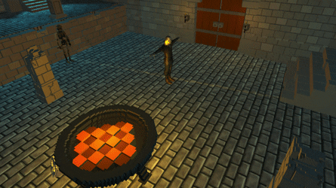
The Game
4
TEAM
Why you would want to play this
Key gameplay mechanics
Smooth character movements / animations
Enemy pathfinding and combat
Time manipulation mechanic

Slide 7
What’s next?
4
TEAM

Slide 8

TEAM 4 DEMO
4
TEAM

